Slide 1


Slide 2
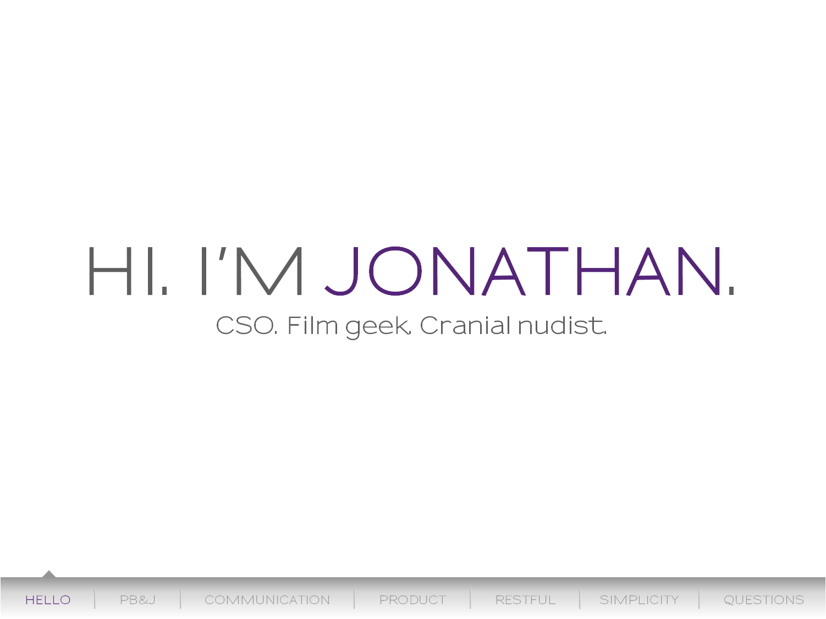

Slide 3
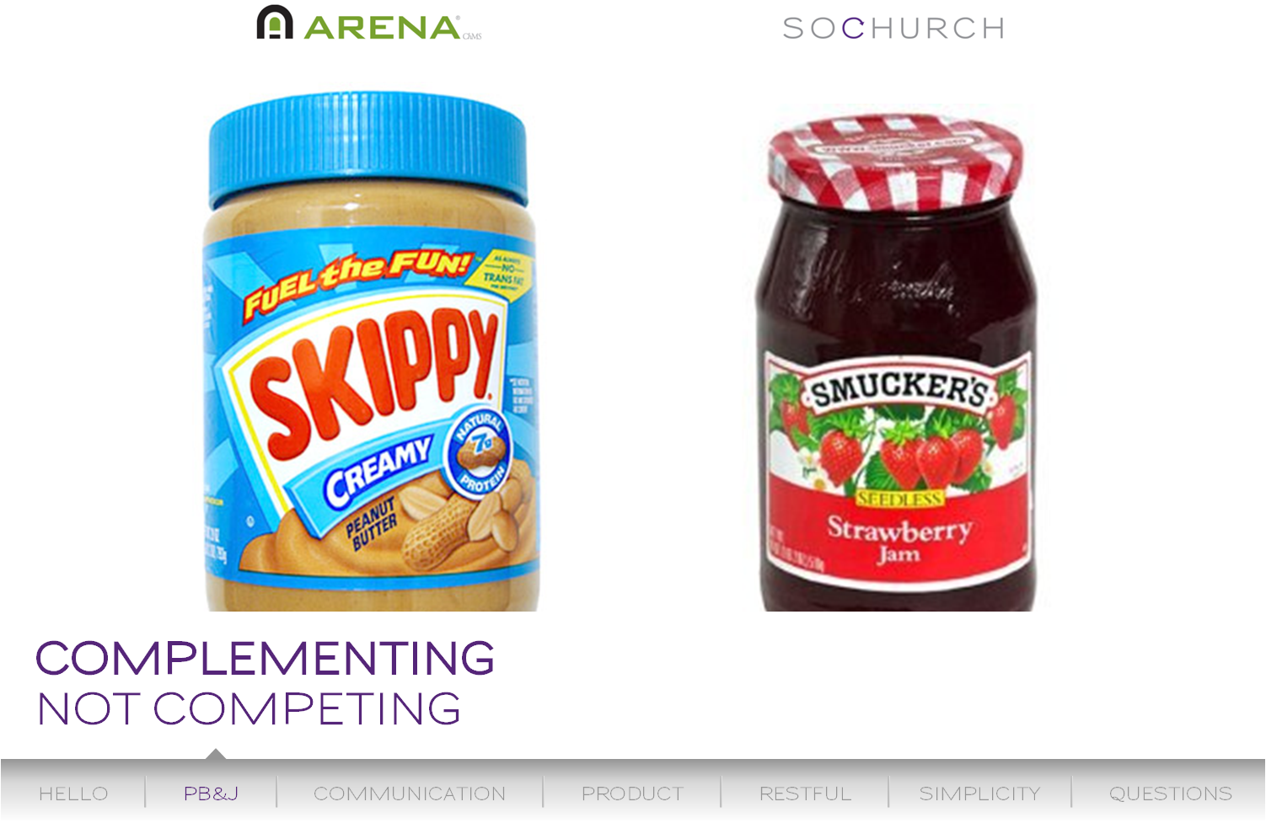

Slide 4
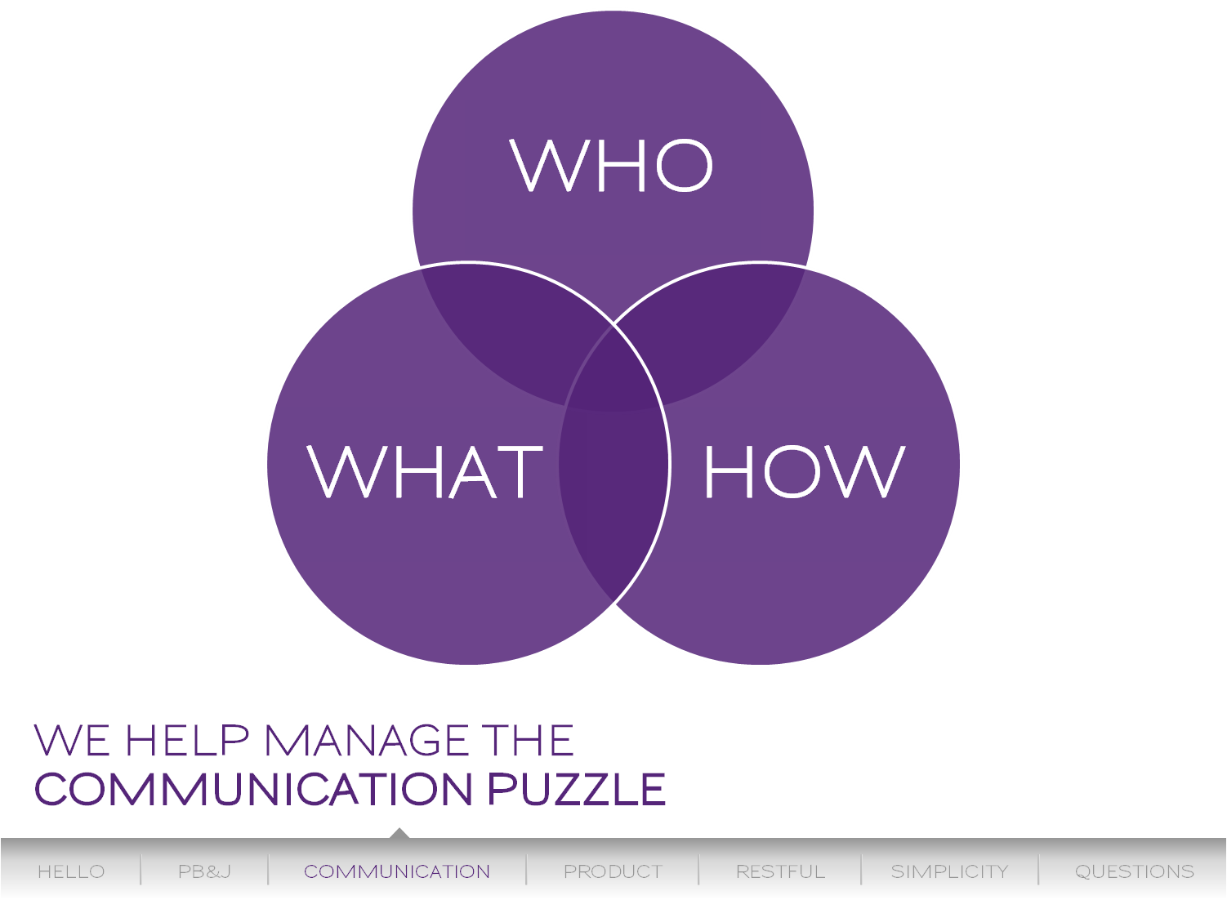

Slide 5
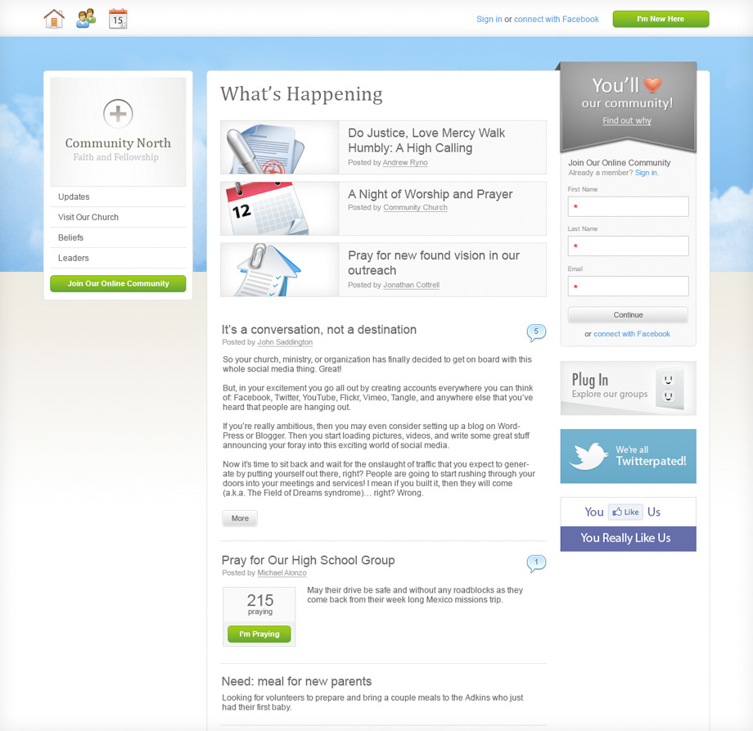

It’s easy to join.
Tell visitors more.
Build community.

Slide 6
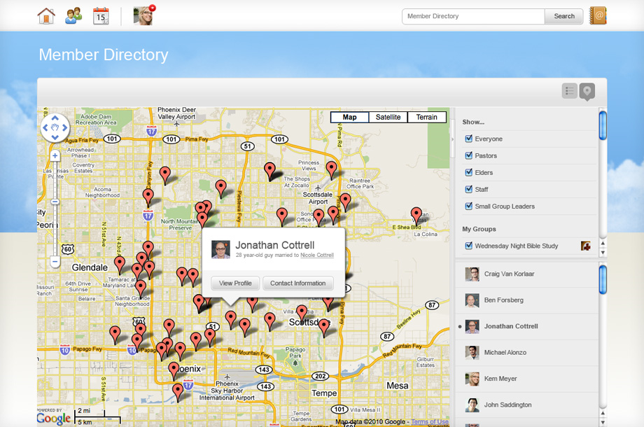
Find people.
Meet people.
Choose your view.

Slide 7
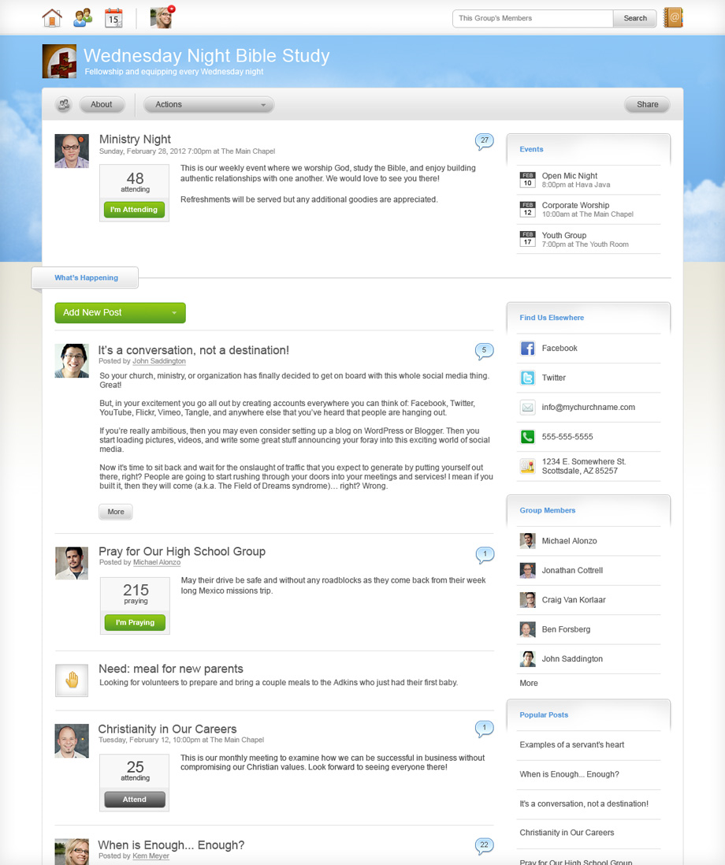
Keep things community-centric.
Add content easily.
Engage
people.

Slide 8
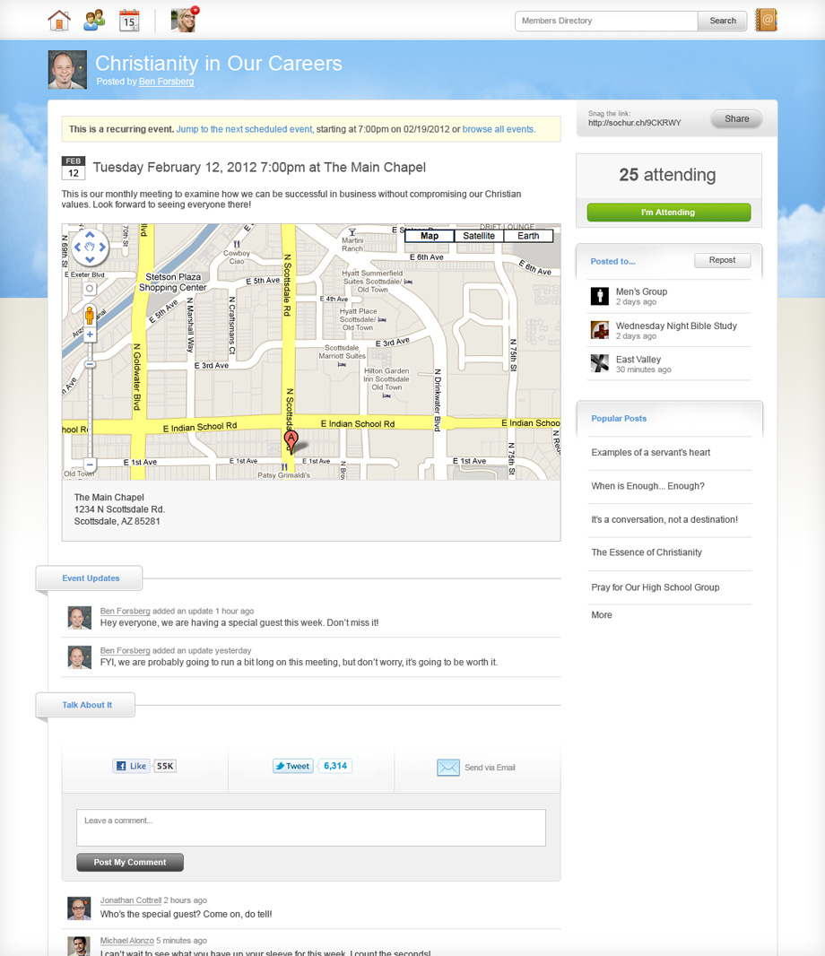
Track attendees.
Update them.
Facilitate easy sharing.

Slide 9
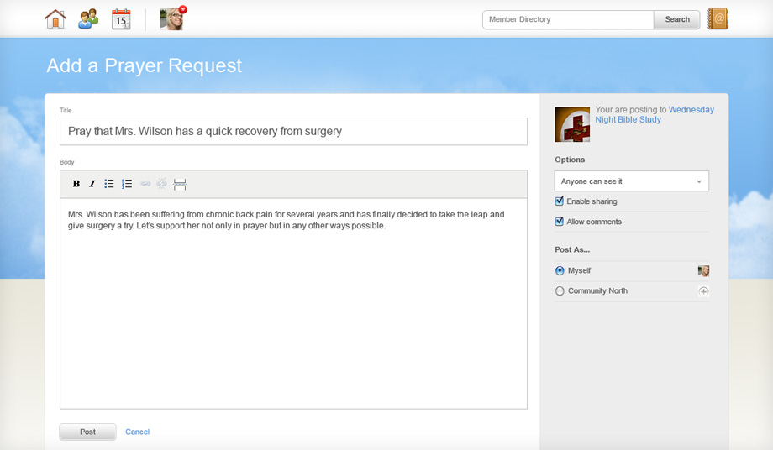
Control the content.
Contribute simply.

Slide 10
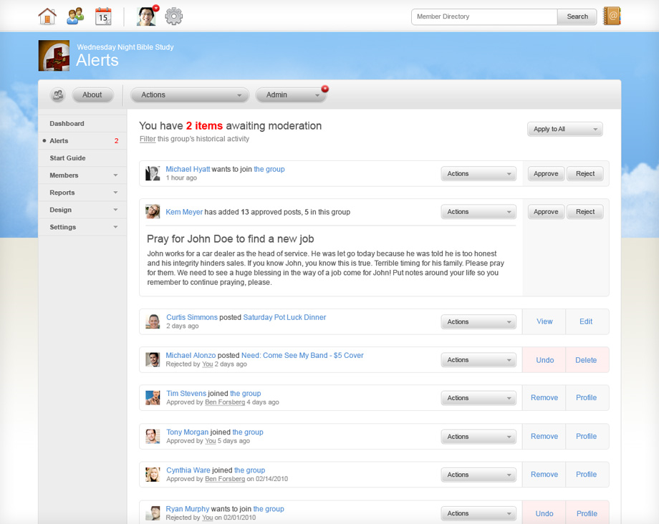
Empower leadership.
Rejoice
admins.
Anyone can do it.

Slide 11



Slide 12




There’s no one that can beat our price. Not even close. But it’s not just inexpensive—it provides more value than the competition even at that low price. We’re looking to meet more churches’ needs at less cost.
Purposefully, our tagline says it all: Church Communication Made Simple. Everything has been designed with the lowest common denominator of technical savvy in mind. And more than that, it just works.
You all intimately know the needs that local ministries have for a product like this. Quite simply, we meet those needs like no one else can. In short, our value, price, user experience, and solution are unparalleled.
Notes:
(Jonathan: 2 min / 1:33-1:35) – You’ve helped us tell the story thus far, and we’re relying upon all of you to continue telling that story. There’s a lot of information to digest that we’ve already shared, but here are the main points we hope you walk away with and continue to reiterate as we move forward.
Big Value, Small Price. We cannot stress enough how important this is. There is no one that even comes close to offering the value that we offer at such a price. Any price concern should be no concern at all.
Made Simple. As Mike already discussed, that “made simple” message that is a part of our tagline has been translated throughout everything we’ve done. Simplicity is key. We’re hear to knock down the complications that church leaders are experiencing with their communication. Our message should be as simple as our product.
Unparalleled. Our solution is unparalleled. Our user experience is unparalleled. Our price is unparalleled. And as you all know from being on this call, our team, with all of your help, is unparalleled. There is nothing like SoChurch, and this should be re-communicated throughout all of our efforts as a team.

Slide 13
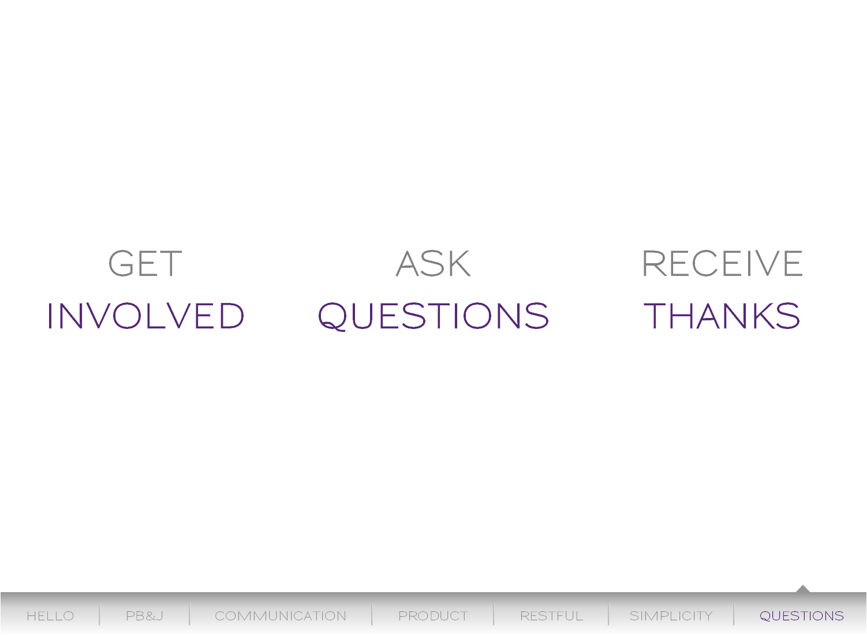
Notes:
(All: 25 min / 1:35-2:00 end) – Answer questions as the come up.
NEXT UP:
We will be launching Alpha on Sept. 3rd. We will be launching R2 on Sept. 21. Look for your invite and provide us feedback as you use the product.
(Ben) John and I will be contacting some of you individually to discuss other ways you may be able to help. Also, be looking for our Executive Dashboard on Sept 3rd with a link and instructions for the alpha testing.
(Ben) dial #88 to end recording

